Slide 1
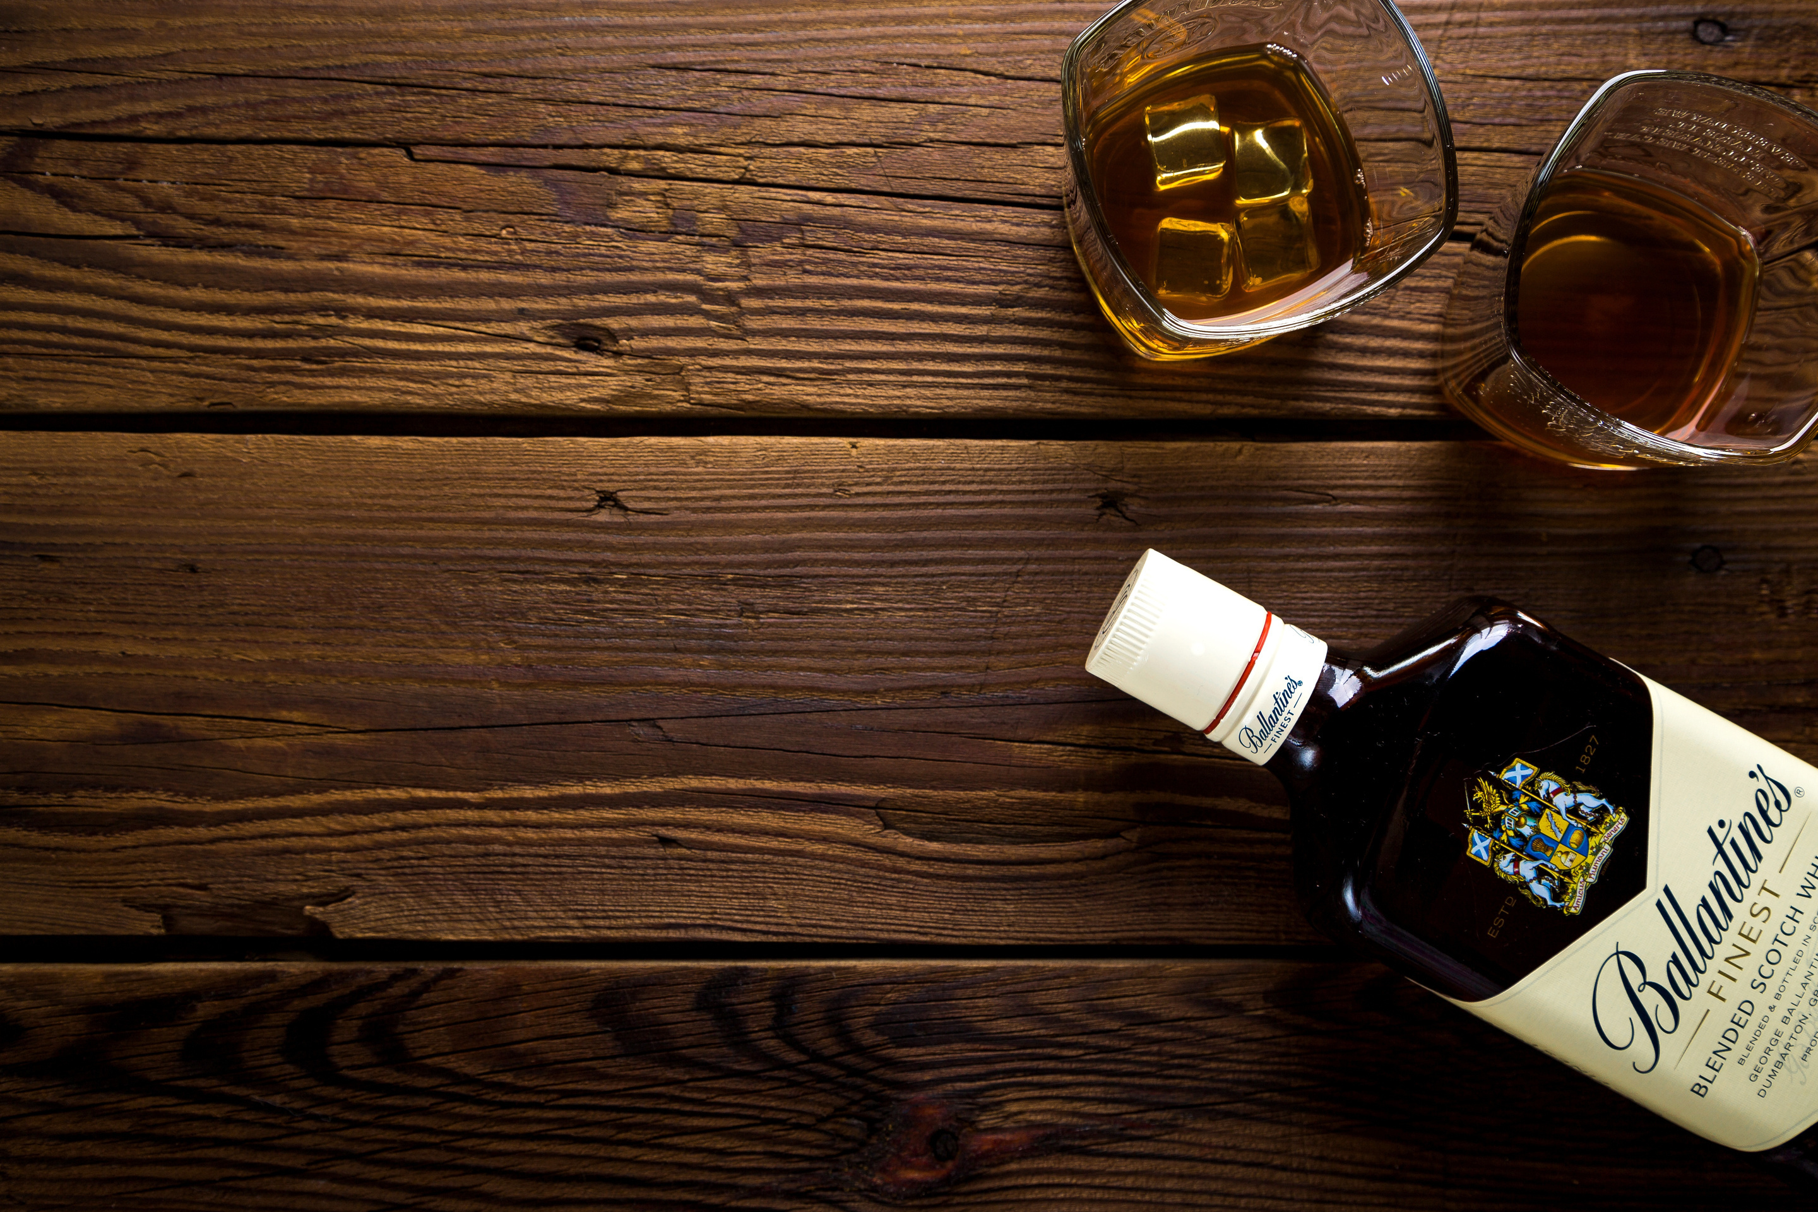

Global Alcohol Consumption
Predicting world alcohol consumption in 2020
Sharon Guy & Netanel Iluz

Slide 2


External resources:
World Health Organization
National Institute on Alcohol Abuse and Alcoholism
Latitude
Wikipedia
Nation Master

Slide 3

Crawling - 1st Acquisition
Step I
Find the desired report (that contains our table)
In the report, locate Table 4 that contains alcohol consuming data of countries in USA
Step II
Acquire data from the table using BeautifulSoup
Save acquired data of countries and alcohol consuming values according to beverage types - beer, wine, spirits and total consumption of the years 2019 - 1977 in dedicated lists
Find the next table page according to its href property

Slide 4
Step III
Repeat Step II for all table pages
Append all data from next pages to the same lists
Create a dataframe with the consuming data of each beverage type for 51 countries over 45 years
Save the dataframe into a .csv format

Slide 5
Crawling - 2nd Acquisition
Step I
Acquire each drink type (beer, wine, spirits) page and save its link in a list
For every drink type page, look for the the link of consumption per capita and go to its address
Step II
Acquire all countries and save their page links in a list
For every country on the list, go the its page
Acquire the table of consumption per year and append the data to a list
Create a dataframe from the lists containing the data of all countries consumption values per drink type over the years
Eventually, we have decided not to use the acquired data from the nationmaster site, since we have discovered that it is similar to the data we have downloaded from the World Health Organization site

Slide 6

Handling missing data
We have decided to remove countries with more than 34 NaN values - meaning years with no consuming data (out of 59 years in total).
All other NaN values were replaced with the median consumption value of each beverage in the specific country over the years.
The same was applied to the USA dataframe.
Each dataframe was organized to fit the machine learning method we had used - Linear Regression.
Eventually, we had 234 countries.
Each country had values of beer consuming, wine consuming, spirit consuming, other beverages consuming and total consuming, for 59 years (2019-1961).

Slide 7

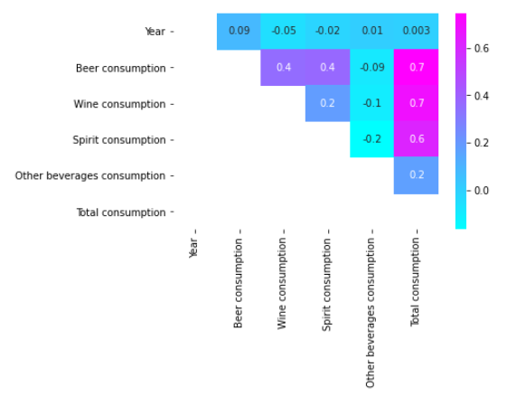
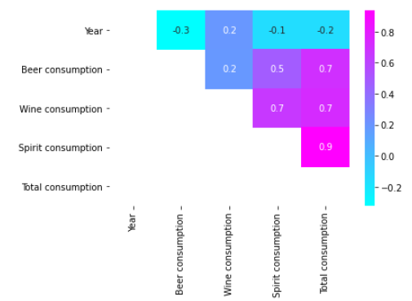
Machine Learning
Data preperation
In order to understand the relations between each beverage consuming data and the total consumption value that we have decided to predict, we have examined 2 heat maps:
Heat map presenting world countries consumption
Heat map presenting USA countries consumption
The same trend was displayed in a pairplot.

Slide 8
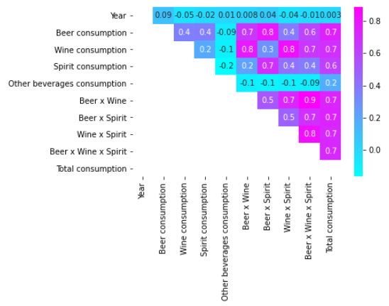
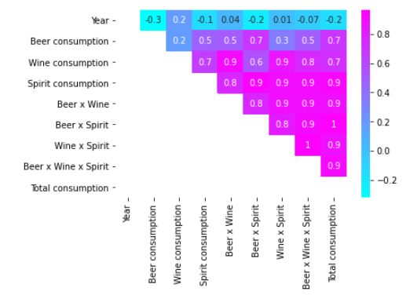
We wanted to perform feature engineering in order to create features that will demonstrate complex relations and help our model be more presice.
We added features multiplying the beverages consumption levels:
Heat map presenting world countries consumption
Heat map presenting USA countries consumption
We have increased the number of features that have strong relation with the total consuming value!

Slide 9
Linear Regression Model
We have chosen to use a model of Linear Regression, since we wish to pedict a value based on previous data.
Our model will build a linear equation based on the previous consumption levels of each beverage type and will predict the total consumption value for each country in 2020.
For each dataframe, we have reserved the most recent years data per country for the prediction.
The rest of the dataframe was divided - 70% for trainig and 30% for testing our model.
The initial precition of our model was good, but we have found some countries that have damaged the model's performance.
We have decided to remove these countries and run the model again.

Slide 10
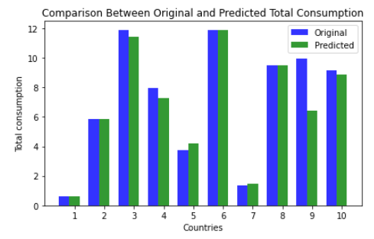
We have managed to get over 90% accuracy in our prediction according to the R-square indicator.
We ran the model again on the data we have reserved for the prediction, and compared our results to the original values of the total consumption for 2019 of 10 selected countries:
We can see that we have high correlation between the original value of total consumption and the value we had predicted!

Slide 11
Now that we know that our model is producing very good results, we can use the data we have predicted to calculate the total alcohol consumption value for each country in 2020.
We had calculated the trend of change in consumption in the predicted values, and had applied it to the most recent year value - of 2019.
The result is a list the estimated alcohol consumption values in 2020 per country, based on the trend of predicted values.

Slide 12

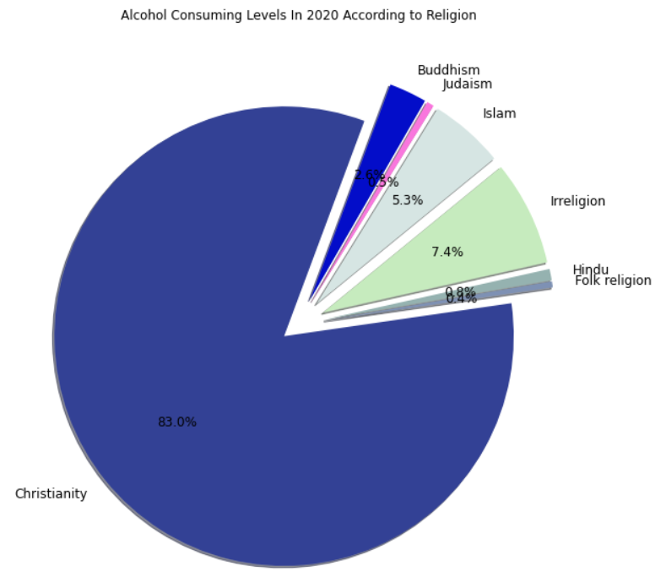
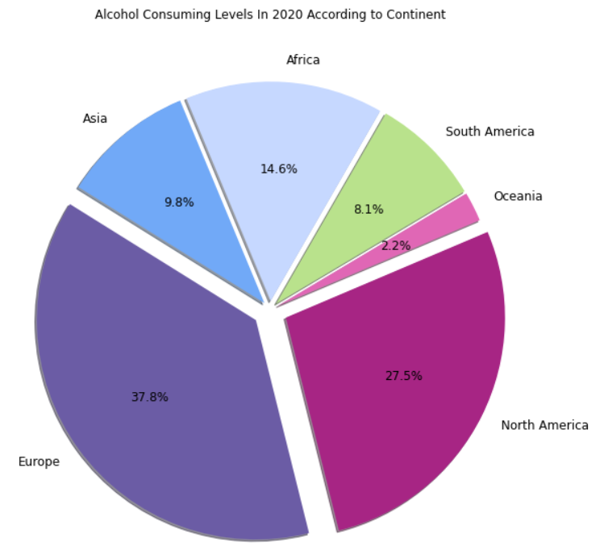
Visualizations

Slide 13
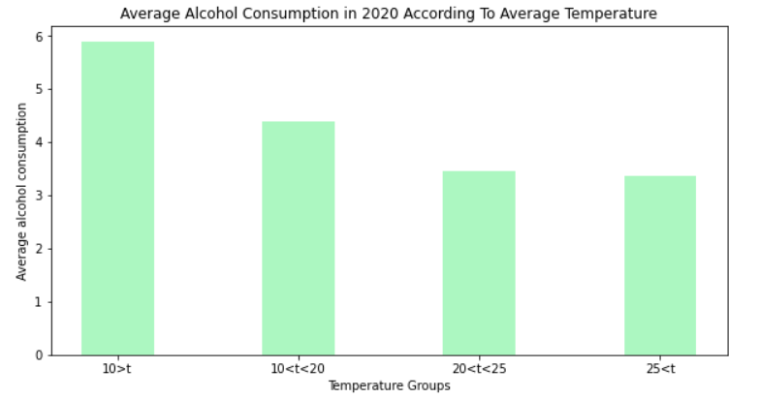
We can see that countries with low temperature, drink more alcohol.
This aligns with the fact that alcohol is often used as a way to keep warm in low temperatures.

Slide 14
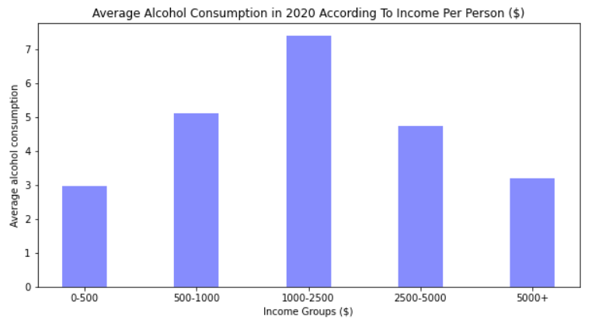
We can see that countries with average income consume more alcohol.
Understandably, in countries with very low income, alcohol is less consumed since the money is usually spent on basic products such as food and clothing.

Slide 15
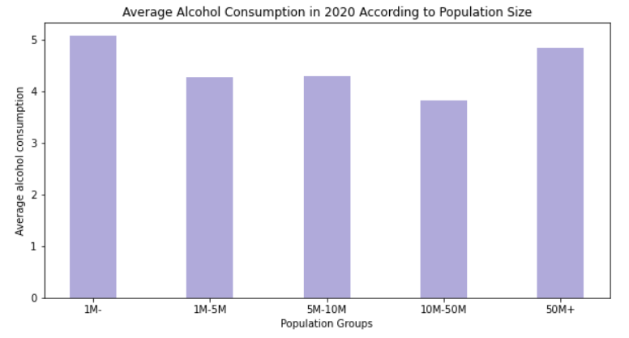
Surprisingly, we can see here that smaller countries consume more alcohol, compared to larger countries.

Slide 16
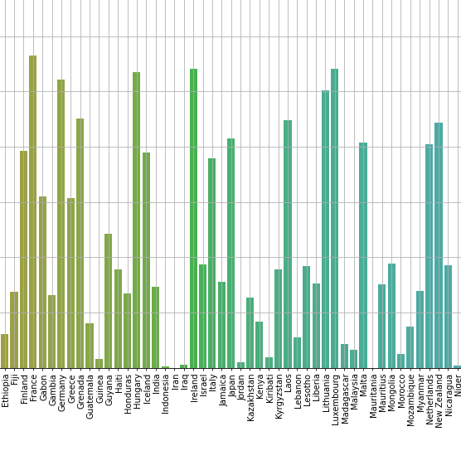
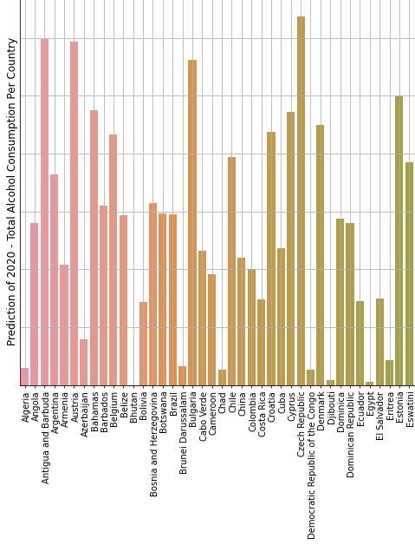
Prediction of 2020 – Total Alcohol Consumption Per Country

Slide 17
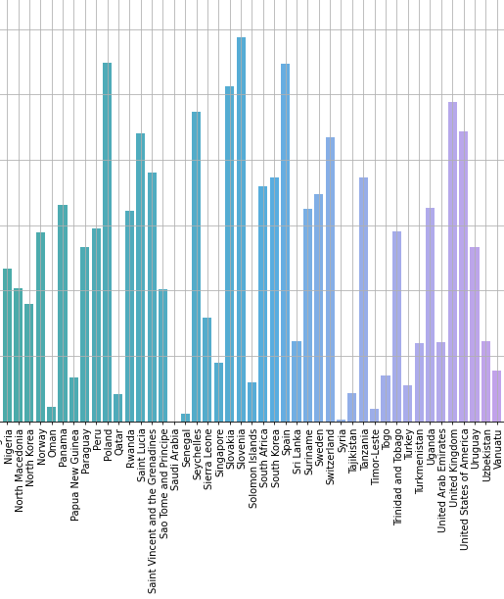
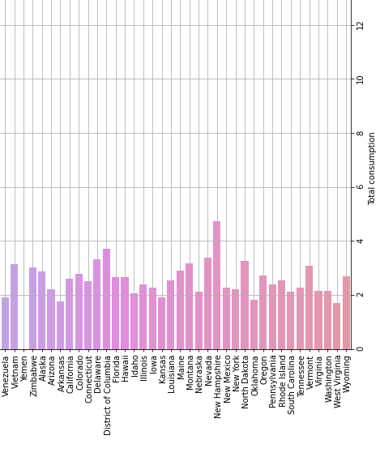
Prediction of 2020 – Total Alcohol Consumption Per Country

Slide 18
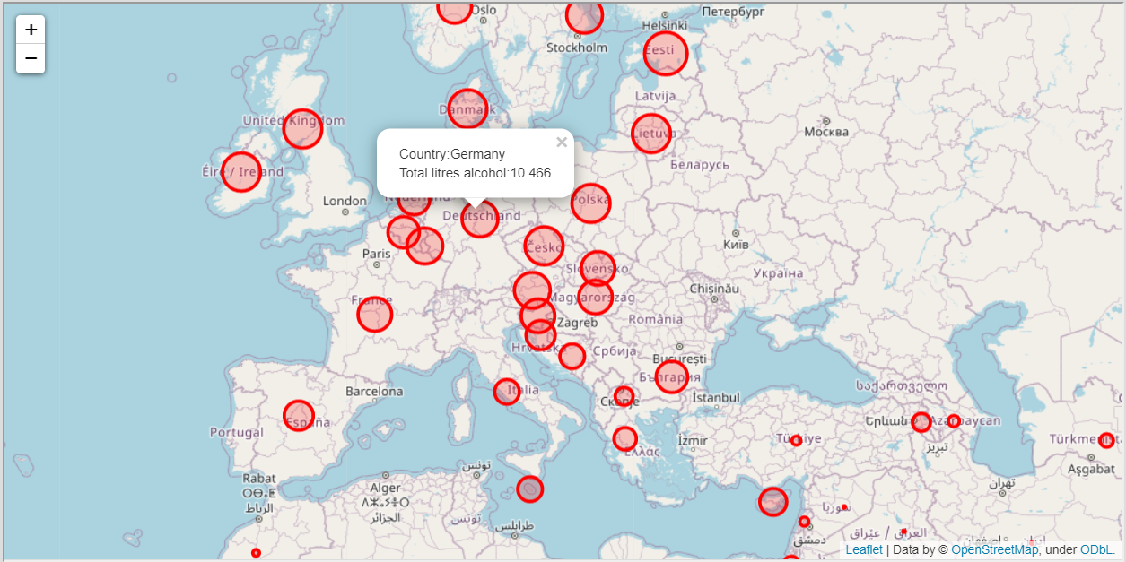
Interactive Map: 2020 Predictions
Link

Slide 19
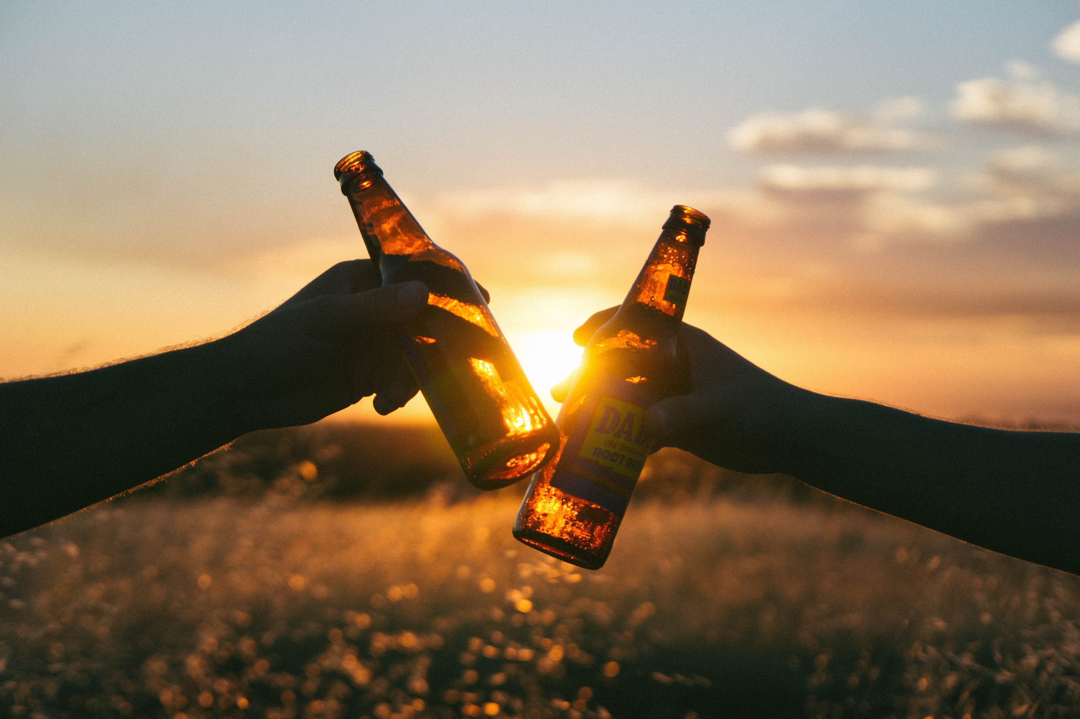
Choose your country and have a drink!

